Slide 1
Generative Sequential Recommendation with GPTRec
Aleksandr V. Petrov and Craig Macdonald University of Glasgow
Russian RecSys Reading Group
https://t.me/ods_recommender_systems

Slide 2
Disclaimer
This is an early version of the work.
Not ready for production yet.

Slide 3
Sequential Recommendation
Predict the next item in the sequence of interactions
I₁
I₂
I₃
I₄
?

Slide 4
Sequential Recommendation and Language Modelling
Sequential Recommendation: Next Item Prediction
It makes sense to adapt language models to sequential recommendation
I₁
I₂
I₃
I₄
?
Language Modelling: Next Token Prediction
GPT
is
a
_{big}
?

Slide 5
Transformers
SOTA in Language Modelling
BERT, GPT, T5, ChatGPT, LLaMA
Transformer
SOTA in Sequential Recommendation
BERT4Rec, SASRec, DuoRec, ALBERT4Rec

Slide 6
Adaptations of Transformer to RecSys
[S]
[|I|xD]
[SxD]
[SxD]
[SxD]
[SxD]
[Sx|I|]
I₁
Embeddings
Matrix
Transformer Block 1
E₁⁽¹⁾
Transformer Block 2
Transformer Block N
Scores₁
E’₁
E₁⁽⁰⁾
E₁^{(N)}
I₂
E’₂
E₂⁽⁰⁾
E₂⁽¹⁾
E₂^{(N)}
Scores₂
+
…
x
I₃
E’₃
E₃⁽⁰⁾
E₃⁽¹⁾
E₃^{(N)}
Scores₃
I₄
E’₄
E₄⁽⁰⁾
E₄⁽¹⁾
E₄^{(N)}
Scores₄
Recommendations
[SxD]
_{Position Embeddings}
S – Sequence length
D – Embeddings size
|I| – Catalogue Size

Slide 7
Problems of Transformer-based models
1. Huge Embeddings Table
2. Huge Scores Table
Can generative models (e.g. GPT) help ?
3. Every score is computed independently

Slide 8
GPT
I₂
I₃
I₄
I₅
GPT
I₁
I₂
I₃
I₄
I₅

Slide 9

How does GPT work: Language Modeling Task
I₁
Embeddings
Matrix
Transformer Block 1
Transformer Block N
E₁^{(N)}
Scores₁
Softmax
P₁=(p₁₁, p₁₂…p_{1|I|})
E’₁
E₁⁽⁰⁾
I₂
E’₂
E₂⁽⁰⁾
E₂^{(N)}
Scores₂
P₂=(p₂₁, p₂₂…p_{2|I|})
+
x
…
I₃
E’₃
E₃⁽⁰⁾
E₃^{(N)}
Scores₃
P₂=(p₂₁, p₂₂…p_{2|I|})
E’_{s}
E_{s}⁽⁰⁾
E₄^{(N)}
Scores_{s}
P_{S}=(p_{s1}, p_{s2}…p_{s|I|})
I_{S}
_{Position Embeddings}
Causal self-attention
$p_{ab}\sim P(I_{a+1}=b|I_{1},I_{2},..,I_{a})$|

Slide 10

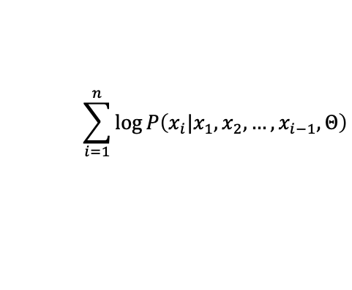




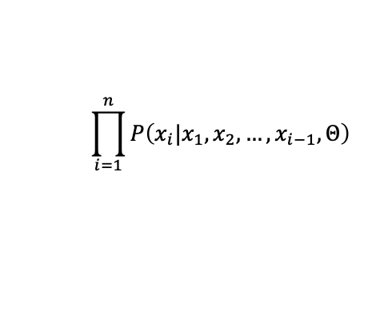
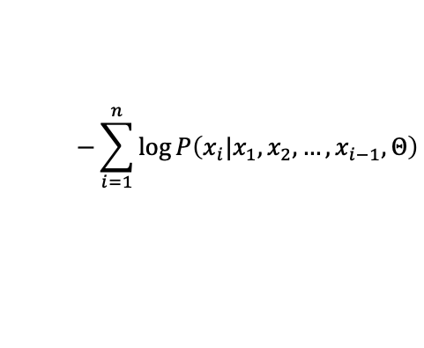
How does GPT work: Language Modeling Task
x₁
x₂
x₃
x₄
x₅
X =
GPT
is
a
transformer
model
GPT-2 is trained to estimate probability of encountering X in D (D – training data)
$P\left(X, Θ\right)=P\left(x_{1},x_{2},…,x_{n},Θ\right)$
$$\prod_{i=1}^{n}{P\left(x_{i}|x_{1},x_{2},…,x_{i−1},Θ\right)}$$
$$−\sum_{i=1}^{n}{\log{P\left(x_{i}|x_{1},x_{2},…,x_{i−1},Θ\right)}}$$
$$=$$
$$=$$
Loss$\left(X, Θ\right)$
$$\sum_{i=1}^{n}{\log{P\left(x_{i}|x_{1},x_{2},…,x_{i−1},Θ\right)}}$$
$$\log{P\left(X, Θ\right)}$$
$$=$$

Slide 11
GPTRec
GPT-2 Based model that uses item ids (or sub-item tokens) and predicts next item
I₂
I₃
I₄
I₅
Very similar to SASRec
GPTRec
Differences with SASRec:
Categorical Cross-Entropy (SASRec uses Binary Cross Entropy)
Minor differences in the architecture (e. g. pre-norm in transformer instead of post-norm)
Supports sub-item tokenization
Supports Next-K generation
I₁
I₂
I₃
I₄
I₅

Slide 12
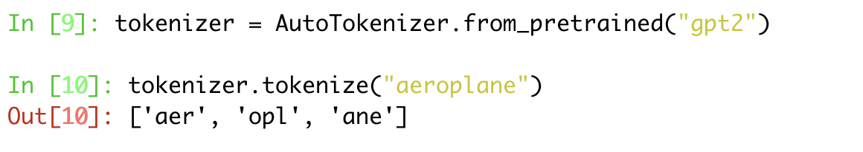
Tokenisation
To reduce memory consumption, Language models split words into sub-word tokens
Any word can be built back from tokens
Relatively small number of tokens is required → Moderate GPU memory consumption

Slide 13
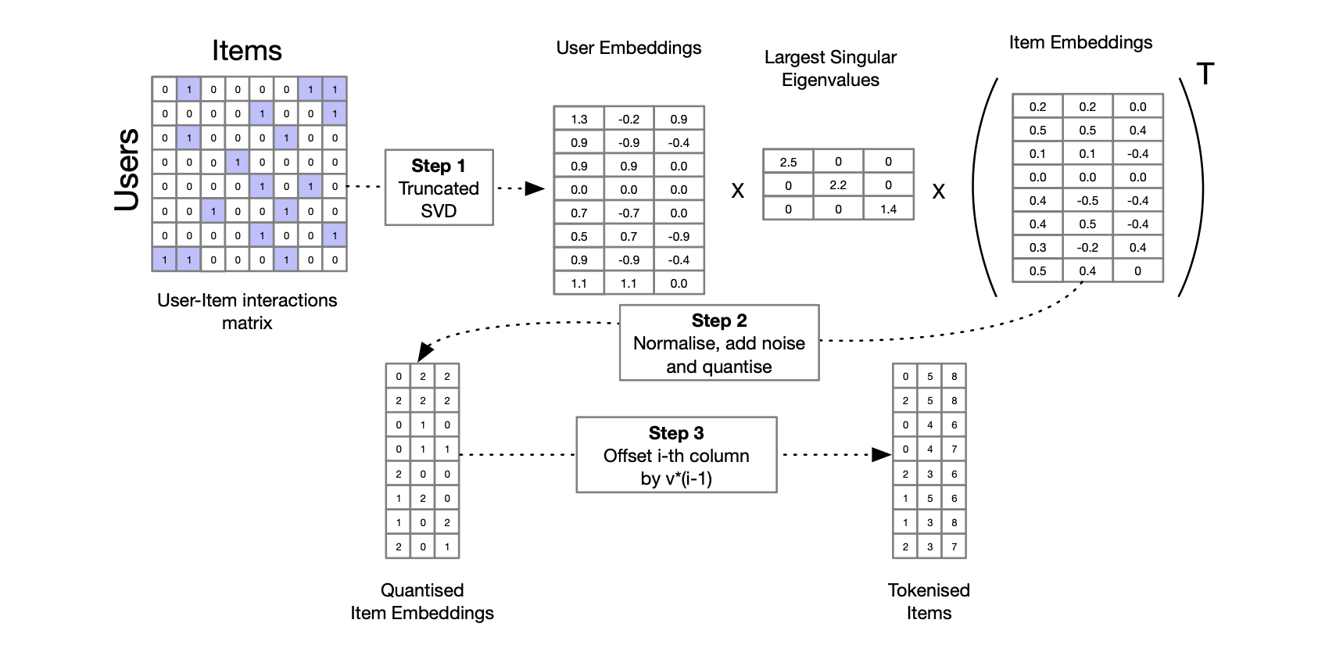
SVD-Tokenisation in GPTRec
Similarly, we can reduce memory consumption via decomposing item-ids into sub-item tokens

Slide 14
SVD-Tokenisation
After SVD-Tokenisation each ItemI Is decomposed into t tokens
To make a recommendation, GPTRec shifts the input sequence t times
We use standard .generate from hugging face transformers to generate multiple candidates
Items are ranked according to the full sequence log-probability from GPTRec

Slide 15
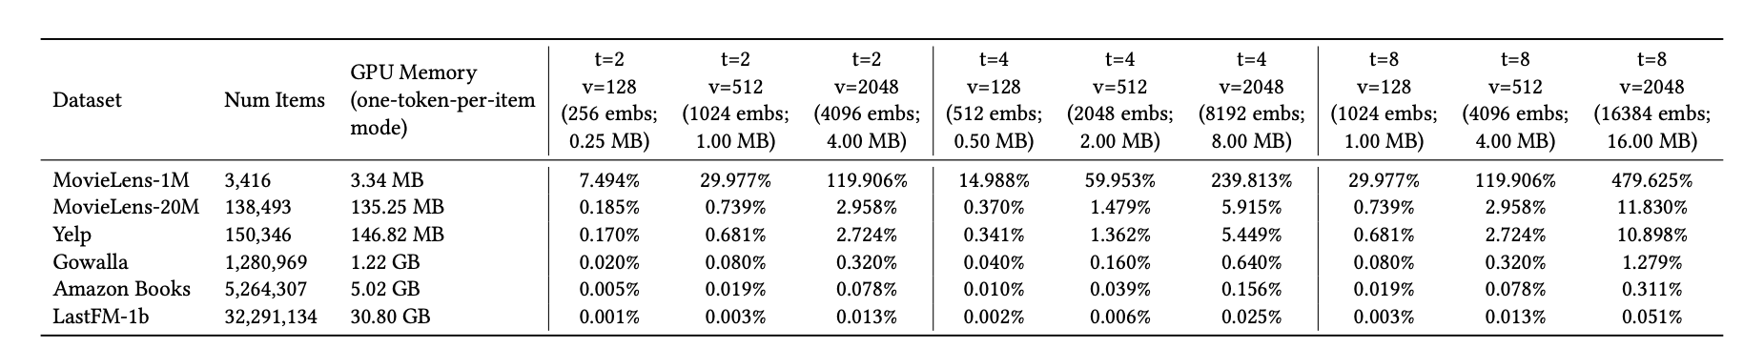
Embeddings table reduction
t = number of tokens per item
v = number of possible items per token

Slide 16
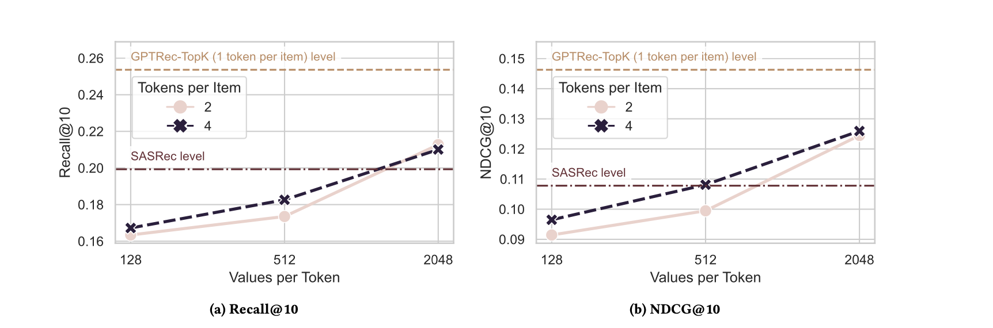
GPTRec performance with vs without Tokenisation
40% smaller embeddings table

Slide 17
Problems of Transformer-based models
SVD tokenisation
1. Huge Embeddings Table
2. Huge Scores Table
3. Every score is computed independently

Slide 18
Next-K strategy
Generate recommendations item-by-item
When we generate next item we already know what was recommended before
Suitable for complex interdependent objectives e.g. novelty
Require further tuning (out of the scope of the paper)

Slide 19
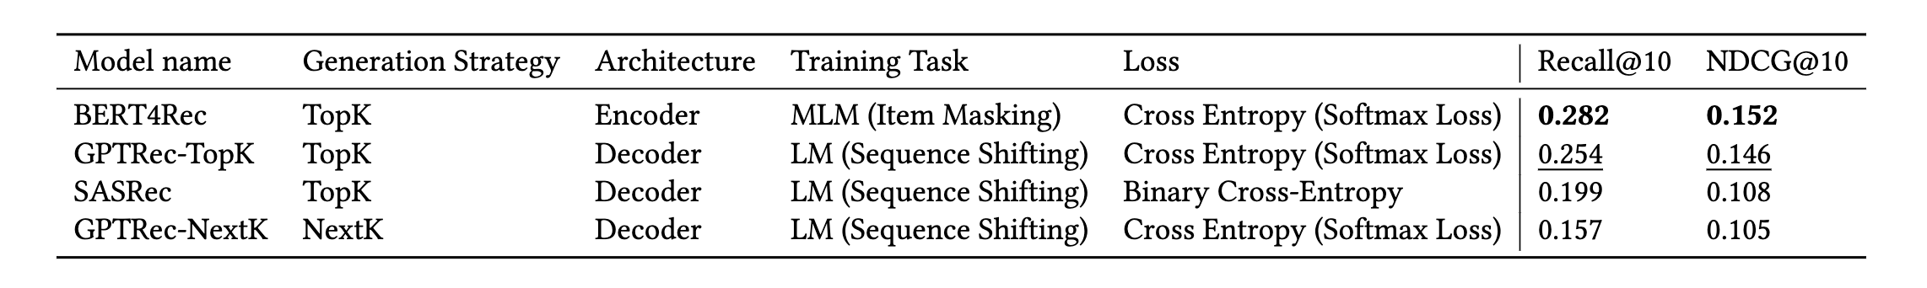
Next-K vs Top-K

Slide 20
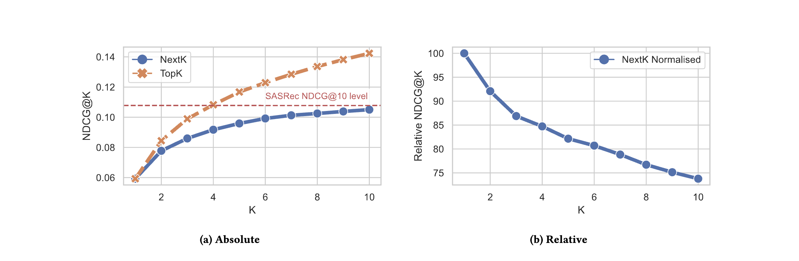
Next-K vs Top-K

Slide 21
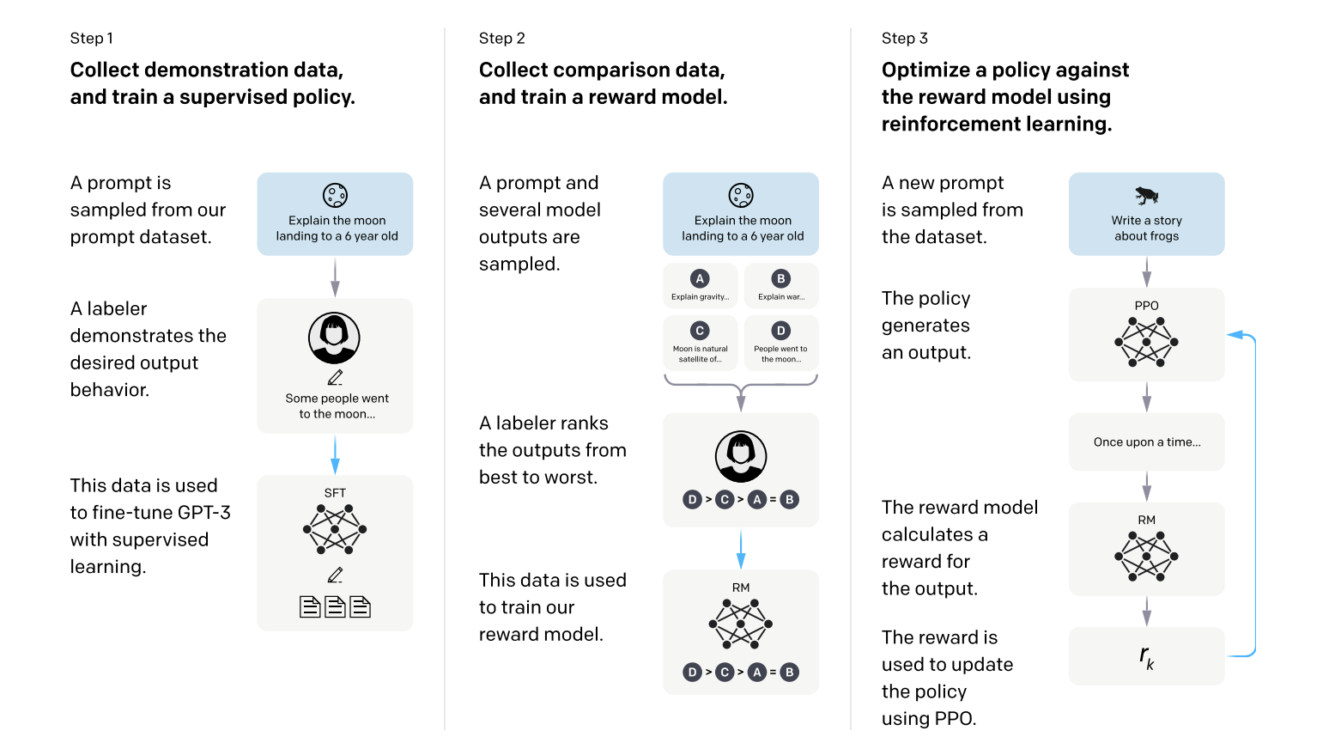
Next-K: ideas for future tuning
Hard to optimize using standard supervised methods
Most likely requires reinforcement learning
Need to add a separator between historical sequence and recommendations
Ouyang, L., Wu, J., Jiang, X., Almeida, D., Wainwright, C., Mishkin, P., Zhang, C., Agarwal, S., Slama, K., Ray, A. and Schulman, J., 2022. Training language models to follow instructions with human feedback. Advances in Neural Information Processing Systems, 35, pp.27730-27744.

Slide 22
Conclusions
GPTRec is a generative model for sequential recommendation
In contrast with SOTA models (SASRec, BERT4Rec) it can be used with datasets with large catalogues (using SVD tokensiation)
It can use Next-K generation strategy for complex tasks, but fine-tuning algorithms need to be developed
We plan to do more experiments (e.g. with more datasets and with more hyperparameter settings)

Slide 23
Q&A

